Slide 1
Publishing your paper

Slide 2
Learning About You
What journals do you have access to? Which do you read regularly?
Which journals do you aspire to publish in and why?
How many of you have published a paper?
How many of you are writing a manuscript now? How many are preparing to write one?
What writing skills do you feel you already have?
What new skills would you like to learn from our workshop today?

Slide 3
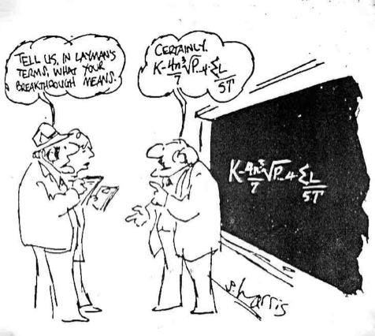
When am I ready to write a manuscript?
Does my data “tell a story” or are they merely pieces of information? (you have to have an answer to a clearly articulated question!)
Do the results I achieved move the state-of-knowledge for the field forward? (don’t just do it because it could be done!)
Is the information I have collected relevant to others? (who really cares anyway?)
XX

Slide 4
Preparing to write a manuscript: the importance of language skills
You need to be proficient in writing in the language of the journal
Many papers do not survive the peer review process if the language is sub-standard
Learn to write well using an appropriate scientific format
Seek out and use any resources available to you (human and otherwise)

Slide 5
Telling your story
Articulate goals and hypotheses
Identify gaps in current understanding
Emphasize how your work will add new knowledge
Know your target audience
Target the most appropriate journal
Attention to detail and format

Slide 6
What makes a good scientific paper?
Evaluated through peer review
Presents original findings
Enough information so experiments can be repeated
Concisely reports the results
Critically evaluates the data and its significance
Data is made available in the public domain (e.g. GenBank)

Slide 7
Scientific organization
Introduction: What question was addressed?
Methods: How was the question studied?
Results: What were your findings?
Discussion: What do these findings mean?
Abstract: Summarizes the main points above without going into detail
Title: Goes last..

Slide 8
Where to submit..
Suitable match for the journal
Appeal to the readership
Quality versus quantity
Journal impact factors
Number of citations
Open access versus subscription only
Speed of publication
Likelihood of success

Slide 9
Preparing the first draft
Read good examples of other works
Sketch out an outline
Methods, Results, Introduction and Discussion
Abstract is last!
Avoid redundancy in data presentation
Use effective graphics
Avoid clutter
Take a break but set deadlines..
Revise until it feels right

Slide 10
Title
Length
Specificity
Syntax
Label not a sentence
Running titles
Avoid abbreviations and jargon

Slide 11
Writing an abstract
Miniature version of the paper
Word limit
Reflect content of the paper
Content
Specific objectives
Principle methods
Summary of results
Main conclusions

Slide 12
Writing the introduction
Sufficient background
Motivation and rational
Outline specific aims
Accessible and interesting
Broad/general to focused/specific
Define specialized terms and abbreviations

Slide 13
Materials and methods
Concise but include full details
Use the past tense
Enough information so study can be reproduced
Outline sites and sampling strategy
Order methods chronologically
Sub-headings can help organize
Use references, tables and figures where appropriate

Slide 14
Reporting the results
Tables and figures are a good way to summarize information
Concise description of experimental findings
Avoid redundant figures etc.
Summarize most important points and refer to raw data in the table or supplementary information
Include appropriate statistical information
Avoid redundancy

Slide 15
Figures and tables
Make your figures legible and easy to read
Label axes appropriately
Avoid a lot of blank space
Use figures to convey the most important results
Use the figure legend to describe what the figure conveys
Use tables and supplementary data to include raw data and summary statistics

Slide 16
Writing the discussion
Discuss but do not restate the results
Point out exceptions to main findings
Acknowledge caveats
Relate main findings to questions raised in the introduction
Emphasize significance of your findings
Avoid over-interpretation
Acknowledge contributions and funding sources

Slide 17
References
Check your references
Format determined by the journal
Citations in text: name, year
Multiple authors: use et al., year
Check citation order system: alphabetical or chronological
Check journal abbreviation styles
Use ENDNOTE or Mendeley

Slide 18
Knowing when to stop revising..
Manuscript includes all necessary information?
Is the information accurate?
Have you been consistent throughout?
Is it logically organized?
Is everything clearly worded
Is your manuscript concise?
Punctuation is correct?
All figures and tables necessary?
Manuscript comply with instructions?

Slide 19
Ethics in publishing
Authenticity and accuracy
Originality
Cite authors appropriately
Simultaneous submission not allowed
Avoid salami science
Ethical treatment of animals (IACUC)
Informed consent for human research (IRB)
Conflicts of interest

Slide 20
Authorship and author order
Individuals who have made a significant contribution
First author is the primary author
Last author signifies the lab or mentor
Usually the first or last author is the corresponding author
Rest are listed in order of importance
Always ask permission for authorship
Discuss authors and order as early as possible

Slide 21
Assignment # 1: Writing an abstract (300 word limit)
Brief introduction
Identification of the gap in our understanding or motivation for the study
Summarize the sampling strategy and/or principal methods used
Provide an overview of the most important results
Discuss the significance of the findings and prospects for future work

