Slide 1
Grant writing
Session II

Slide 2
Overall structure .. revisited
Title
Project summary (one page)
Project description (5 - 15 pages)
References (may be limited)
Description of personnel (CVs)
Research infrastructure
Budget and justification
Time-line
Suggested reviewers

Slide 3
What is in a title?
Succinct and ambiguous
Attractive title..
Too descriptive (too narrow)
Too broad (unachievable and unfocused)
Avoid jargon, buzzwords or words that are too informal
Avoid over-statement
Can you provide any examples?

Slide 4
The project summary

Slide 5
Writing the project summary
Must encapsulate all the critical elements of the proposal
What problem will you study and why is it important?
What methods will you use and why did you choose them?
What results do you expect and how will you analyze them?
How will your study benefit science, the agency that funded it and society as a whole?

Slide 6
First paragraph
Describe the broader context of your proposal
Outline your specific questions, hypotheses or specific aims
Identify gaps in our understanding
Summarize techniques and methods that you will adopt
Outline what you plan to do

Slide 7
Second paragraph
Emphasize the overall intellectual merit of the work
How proposal will advance immediate area of study
Broader implications of study to other areas of science
Benefits to society

Slide 8
Project description
Introduction and justification
Overall goal and hypotheses
Specific aims
Proposed methods
Preliminary data
Expected results and their significance

Slide 9
Introduction and justification
Organize clearly and concisely
Highlight novelty and importance
Guide reader (specific aims)
Explain value of your work
Unify with other fields
But be reasonable..
Emphasize significance

Slide 10
Overall goal, hypotheses and specific aims of the study
State OVERALL objective
State main hypotheses and predictions
Outline specific aims of this study:
Specific aim #1:
Specific aim #2:
Specific aim #3:
For each specific aim outline the methods that will be used and any preliminary data

Slide 11
Using conceptual models
Use a concept map to help integrate different aspects of the study

Slide 12
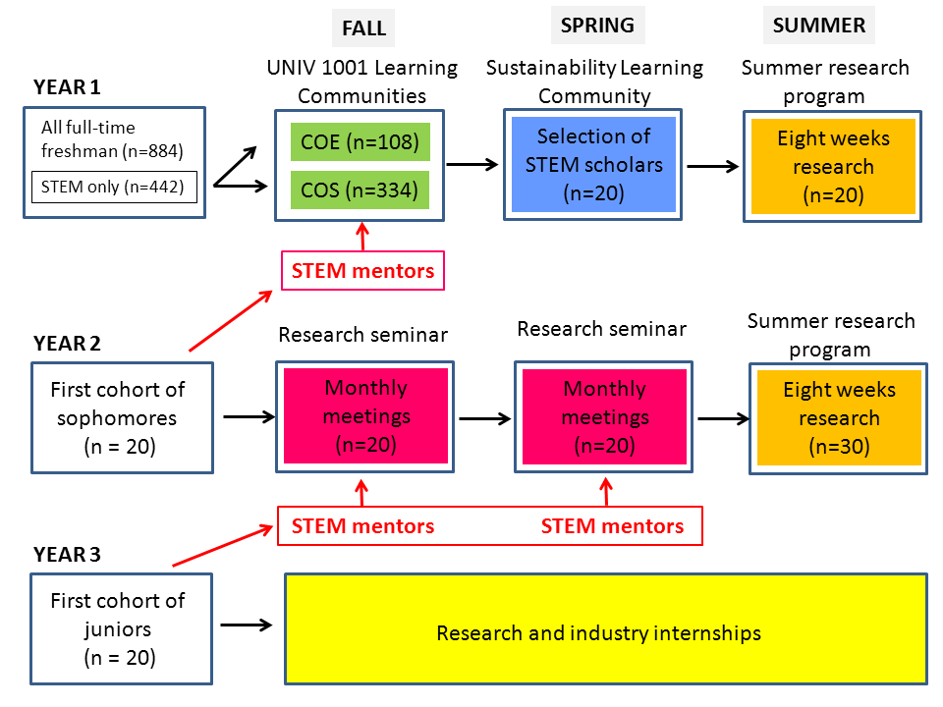
And illustrate the time-line of the project..

Slide 13
Research methods: organization
ORDER of methods mirrors specific aims..
Avoid needless repetition
Avoid long lists
Describe species, system and sampling protocol..
Specific aim #1
Hypothesis to be tested
Experimental protocol #1
Data analysis #1 (or combine in a common section)

Slide 14
Sampling strategies and experimental design
Methods vary according to species
(a) complete counts e.g. large mammals
(b) random sampling (stratified or not?)
quadrats or plots e.g. plants
line transect e.g. dung, nests
point counts e.g. birds
mark-release-recapture e.g. small mammals

Slide 15
Planning for the unexpected..
Describe alternative outcomes, illustrate graphically, use diagrams or simulations
Illustrate how research findings will be interpreted under different outcomes
Acknowledge limitations and expected outcomes under different scenarios

Slide 16
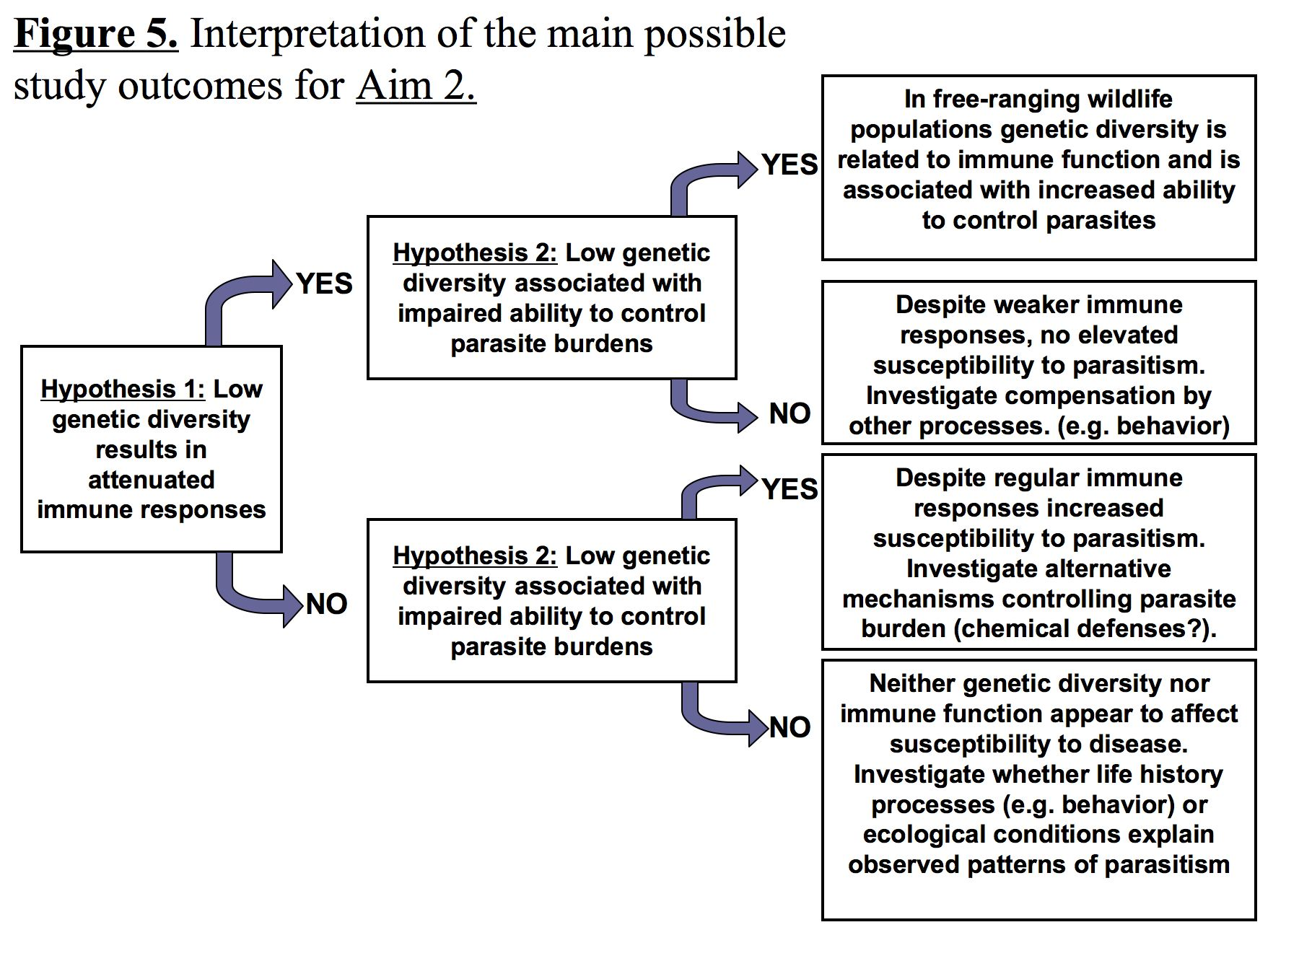

Slide 17
Construct a realistic time-line
Activity | 1-3 months | 4-6 months | 7-9 months | 10-12 months
Sampling | X | X
Sequencing |  | X | X
Data analysis |  |  | X | X
Final report |  |  |  | X
Outreach |  |  |  | X

Slide 18
Facilities and resources
Emphasize special facilities and equipment
Highlight your success in prior work
Show that you can leverage existing infrastructure
Emphasize the role of collaborating personnel and institutions

Slide 19
Budget and justification
Direct costs versus indirect costs (overhead)
Budget items:
- Salaries and benefits
PI minimal
Mostly for postdocs, GAs and undergraduate students
Equipment (essential for project)
Supplies (VERY important)
Travel and participant support
Miscellaneous
Sub-contracts
Cost sharing

Slide 20
Review process
In house program managers
External panelists
Ad hoc reviewers
Conflicts of interest
Panel summary and reviewer comments
Decision do/do not fund
Don’t despair and call a program officer

Slide 21
Rethink, revise and resubmit
Expect your proposal to fail!
Consider other funding agencies and request feedback
Classify comments – must consider, may consider and ignore
Write a resubmission response (if allowed)
Summarize main comments
Indicate how they have been addressed
Do not dwell on minutiae
Explain why some comments not addressed
Emphasize the strengths identified by reviewers

Slide 22
In summary
Read the guidelines and make a checklist of key points to address
Show how your project will contribute to the funder’s mission
Position your important points strategically
Never stop selling
Don’t propose too much and be realistic
Make it easy for your reviewers
Allow time to write and revise
Never give up!!

